Slide 1
Step by step to setup Sherpaerp Library
Spring Boot

Slide 2
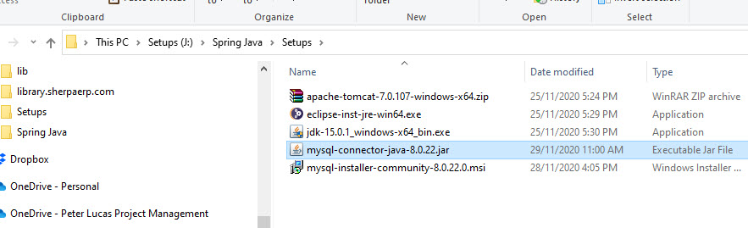
Required on Win10

Slide 3
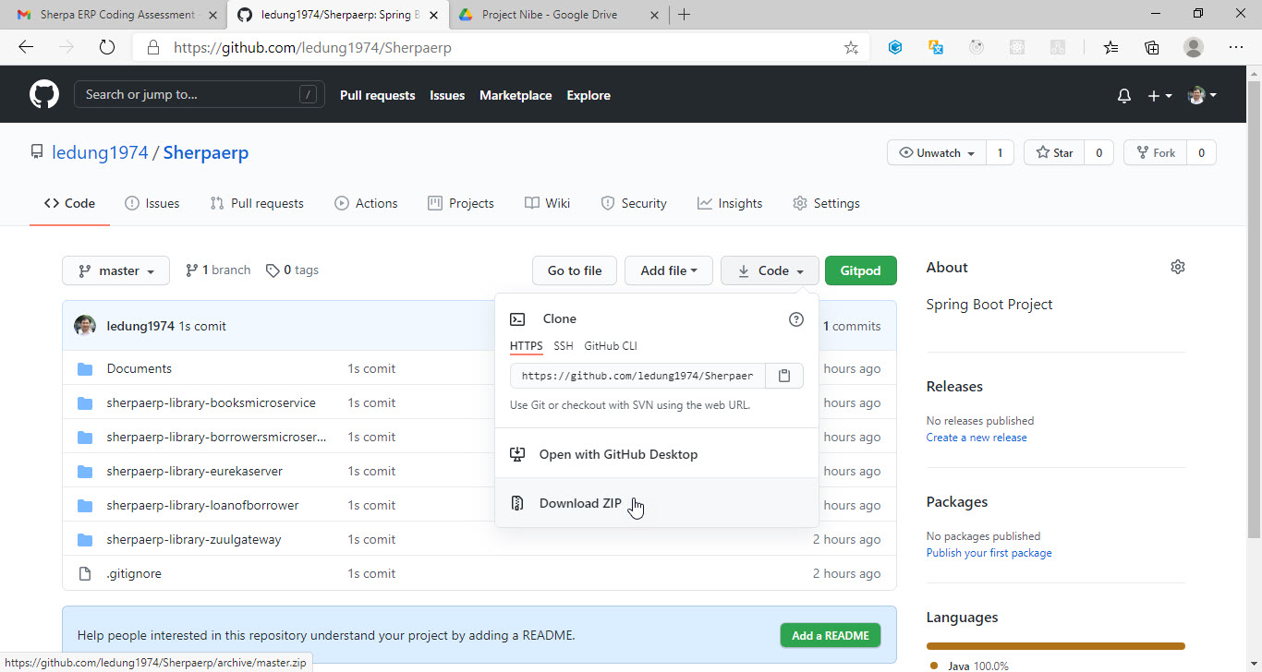
Download from GitHub

Slide 4
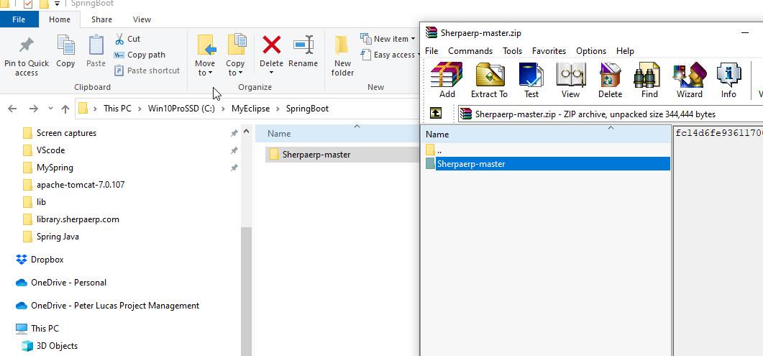
UnZip files -> a project folder

Slide 5
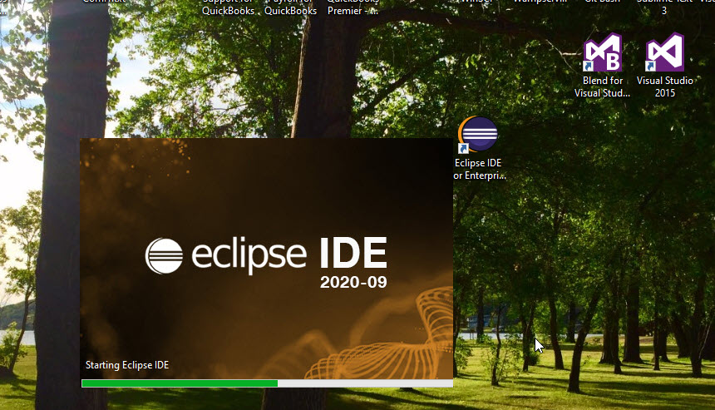
Run Eclipse

Slide 6
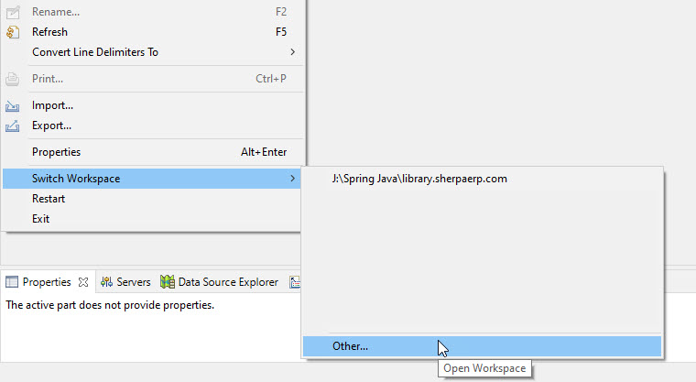
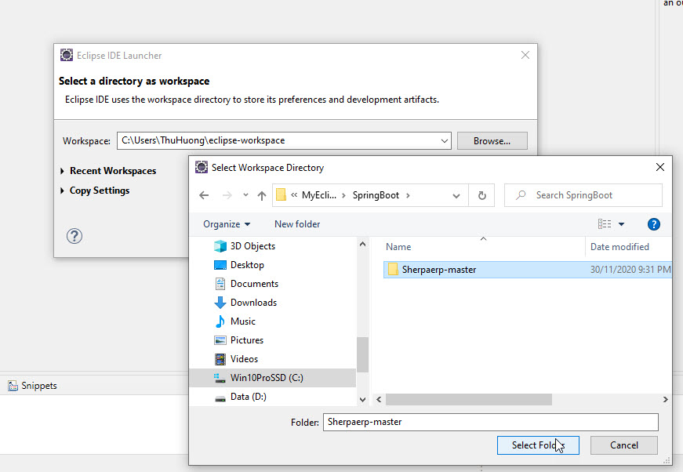
Switch a new workspace …

Slide 7
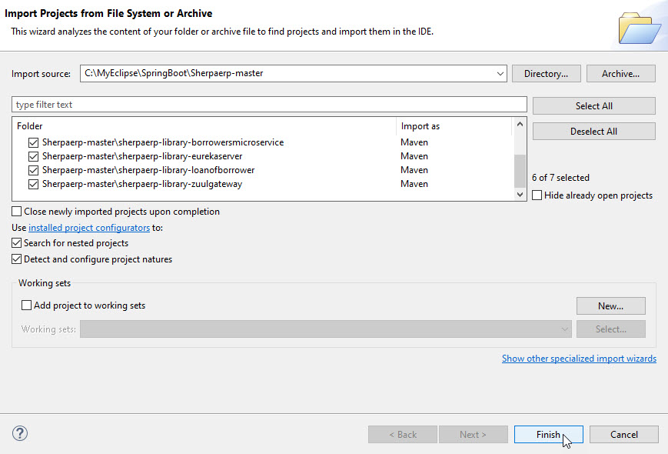
Import Project from File System

Slide 8
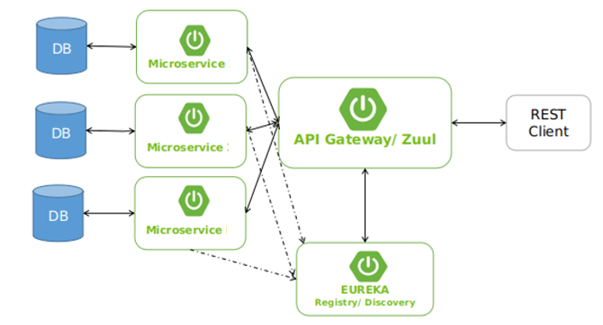
Modules Design
MySQL
Books Microservice
tbbooks
Loans of Borrowers Microservice
Port: 8888
tbloans
Proxy Service
tbborrower
Borrowers Microservice

Slide 9
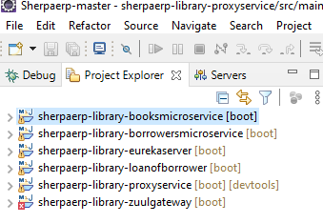
Project structure
+ Eurekaserver
+ Proxy-service
+ Micrcoservices
Borrowers service
Books service
LoanOfBorrower service
+ Database: MySQL
+ Ruul gateway*
Ruul is now maintaining → not running
RibbonClient is also maintaining

Slide 10
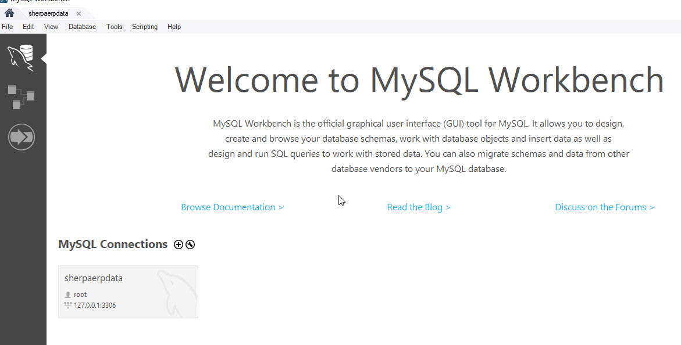
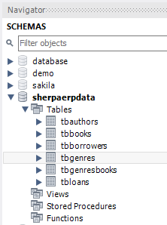
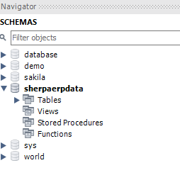
Run MySQL Server – Create Scheme: Sherpaerpdata

Slide 11
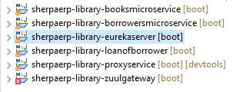
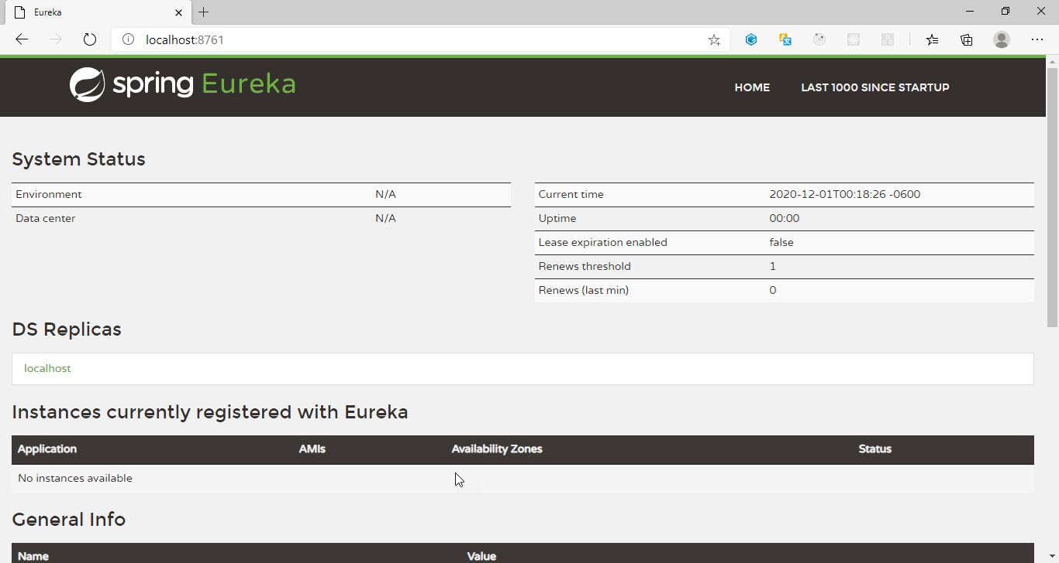
Run Eureka service first

Slide 12
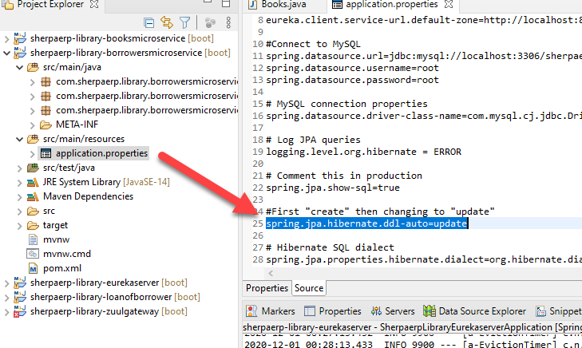
Run 3 microservices in the first time to “create” all MySQL tables (auto by Hibernate)
Then change application.properties – spring.jpa.hibernate.ddl-auto : create → update

Slide 13
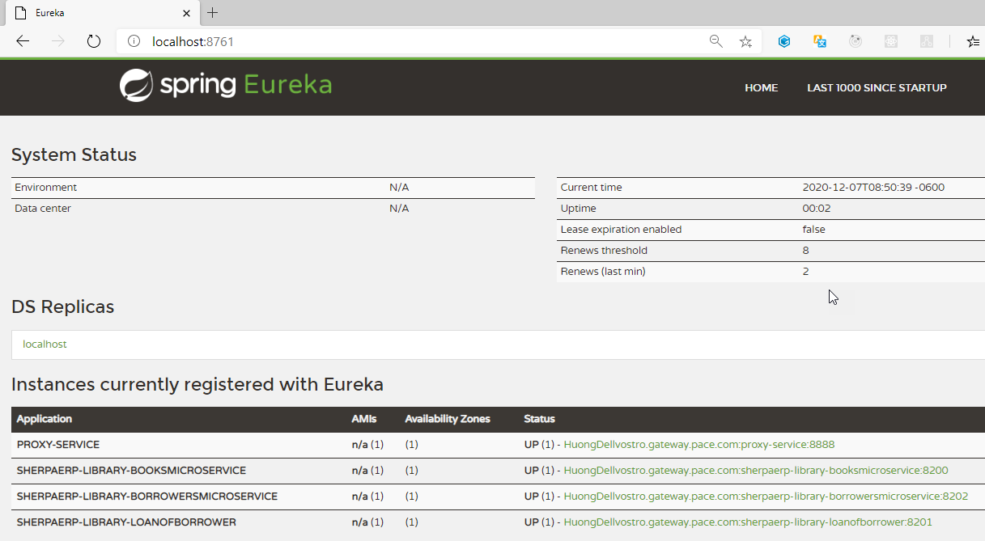
Run 3 mircoservices at port 8200, 8201,8202 and then run Proxy-service at port 8888 with Eureka server port 8761

Slide 14





Run Book_microservice at localhost:8200/books/ then can testing /add /list /find
localhost:8200/books/add?title=Gone with the wind&firstname=Margaret&lastname=Mitchell&genres=Historical fiction&pageCount=1037
tbbooks
tbgenresbooks
tbgenres
tbauthors

Slide 15
Test cases for Books Microservice at localhost:8200/books/
http://localhost:8200/books/add?title=T1&firstname=AF1&lastname=AL1&genres=g1&pageCount=111
http://localhost:8200/books/add?title=T2&firstname=AF2&lastname=AL2&genres=g2,g3&pageCount=222
http://localhost:8200/books/add?title=T3&firstname=AF2&lastname=AL2&genres=g1,g4&pageCount=333
http://localhost:8200/books/add?title=T4&firstname=AF3&lastname=AL3&genres=g5,g6&pageCount=444
http://localhost:8200/books/add?title=T3&firstname=AF2&lastname=AL2&genres=g1,g4&pageCount=333
The book with title: [T3] by author [AF2 AL2] has already been in the database. So, the addition is canceled.
http://localhost:8200/books/add?title=T3&firstname=AF4&lastname=AL4&genres=g7&pageCount=555
A new book by a new author has just been added to the database!
http://localhost:8200/books/list
[{"id":1,"title":"T1","author":{"firstname":"AF1","lastname":"AL1"},"pageCount":111,"genres":[{"name":"g1"}]},
{"id":2,"title":"T2","author":{"firstname":"AF2","lastname":"AL2"},"pageCount":222,"genres":[{"name":"g2"},{"name":"g3"}]},
{"id":3,"title":"T3","author":{"firstname":"AF2","lastname":"AL2"},"pageCount":333,"genres":[{"name":"g1"},{"name":"g4"}]},
{"id":4,"title":"T4","author":{"firstname":"AF3","lastname":"AL3"},"pageCount":444,"genres":[{"name":"g5"},{"name":"g6"}]}]
http://localhost:8200/books/find?id=3
[{"id":3,"title":"T3","author":{"firstname":"AF2","lastname":"AL2"},"pageCount":333,"genres":[{"name":"g1"},{"name":"g4"}]}]
http://localhost:8200/books/find?title=T4
[{"id":4,"title":"T4","author":{"firstname":"AF3","lastname":"AL3"},"pageCount":444,"genres":[{"name":"g5"},{"name":"g6"}]}]
http://localhost:8200/books/find?title=T2&author=AF2,AL2
[{"id":2,"title":"T2","author":{"firstname":"AF2","lastname":"AL2"},"pageCount":222,"genres":[{"name":"g2"},{"name":"g3"}]}]

Slide 16
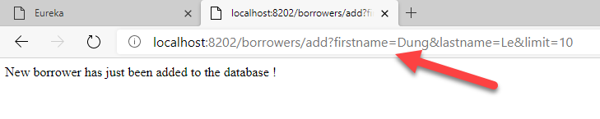
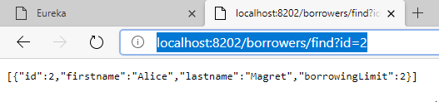
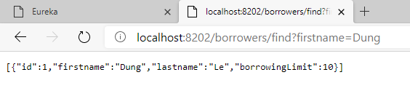
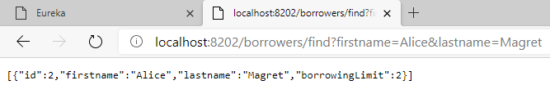
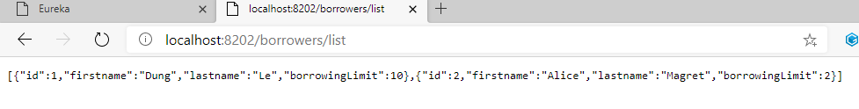
Run Borrowers microservice at localhost:8202/borrowers/ and then can test /add, /find /list

Slide 17
Test cases Borrowers microservice at localhost:8202/borrowers/ /add, /find /list
http://localhost:8202/borrowers/add?firstname=BF1&lastname=BL1&limit=11
http://localhost:8202/borrowers/add?firstname=BF2&lastname=BL2&limit=22
http://localhost:8202/borrowers/add?firstname=BF3&lastname=BL3&limit=33
http://localhost:8202/borrowers/add?firstname=BF3&lastname=BL3&limit=44
The name: BF3 BL3 has already been in the database. So, the addition is canceled.
http://localhost:8202/borrowers/list
[{"id":1,"firstname":"BF1","lastname":"BL1","borrowingLimit":11},
{"id":2,"firstname":"BF2","lastname":"BL2","borrowingLimit":22},
{"id":3,"firstname":"BF3","lastname":"BL3","borrowingLimit":33}]
http://localhost:8202/borrowers/find?id=2
[{"id":2,"firstname":"BF2","lastname":"BL2","borrowingLimit":22}]
http://localhost:8202/borrowers/find?firstname=BF3&lastname=BL3
[{"id":3,"firstname":"BF3","lastname":"BL3","borrowingLimit":33}]
http://localhost:8202/borrowers/find?firstname=BF4&lastname=BL4
[]

Slide 18
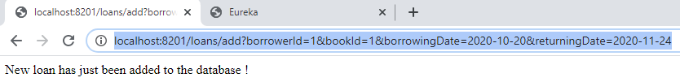

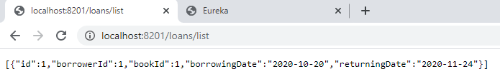

Run LoanOfBorrower Microservice at localhost:8201/loans/ and then can test /add, /list /find
http://localhost:8201/loans/add?borrowerId=1&bookId=1&borrowingDate=2020-10-20&returningDate=2020-11-24
tbloans
http://localhost:8201/loans/list
localhost:8201/loans/find?bookId=2

Slide 19
Test cases LoanOfBorrower microservice at localhost:8201/loans/ /add, /find /list
http://localhost:8201/loans/add?borrowerId=1&bookId=1&borrowingDate=2020-10-20&returningDate=2020-11-24
New loan has just been added to the database.
http://localhost:8201/loans/add?borrowerId=1&bookId=2&borrowingDate=2020-10-24&returningDate=2020-11-24
New loan has just been added to the database.
http://localhost:8201/loans/add?borrowerId=1&bookId=2&borrowingDate=2020-10-24&returningDate=2020-11-28
The loan has already been in the database. So, the addition is canceled.
http://localhost:8201/loans/list
[{"id":1,"borrowerId":1,"bookId":1,"borrowingDate":"2020-10-20","returningDate":"2020-11-24"},
{"id":2,"borrowerId":1,"bookId":2,"borrowingDate":"2020-10-24","returningDate":"2020-11-24"}]
http://localhost:8201/loans/find?bookId=2
[{"id":2,"borrowerId":1,"bookId":2,"borrowingDate":"2020-10-24","returningDate":"2020-11-24"}]
http://localhost:8201/loans/find?borrowerId=1
[{"id":1,"borrowerId":1,"bookId":1,"borrowingDate":"2020-10-20","returningDate":"2020-11-24"},
{"id":2,"borrowerId":1,"bookId":2,"borrowingDate":"2020-10-24","returningDate":"2020-11-24"}]
http://localhost:8201/loans/find?borrowerId=2
[]

Slide 20
Run all services from Proxy-Service http//localhost:8888 I. Books Service at → http//localhost:8888/books
Add new book (checking book in the database before add)
http://localhost:8888/books/add?title=T1&firstname=AF1&lastname=AL1&genres=g1,g2&pageCount=111
List all books
http://localhost:8888/books/list
Get a book by ID=1
http://localhost:8888/books/getid/1
Find a book by title=T1
http://localhost:8888/books/find?title=T1
Find a book by title and author=firstname,lastname
http://localhost:8200/books/find?title=T2&author=AF2,AL2

Slide 21
Run all services from Proxy-Service http//localhost:8888 II. Borrowers Service at → http//localhost:8888/borrowers
Add new borrower (checking borrower in the database before add)
http://localhost:8888/borrowers/add?firstname=BF1&lastname=BL1&borrowingLimit=11
List all borrowers
http://localhost:8888/borrowers/list
Get a borrowers by ID=1
http://localhost:8888/borrowers/getid/1
Find a borrower by fullname (firstname and lastname)
http://localhost:8888/borrowers/find?firstname=BF1&lastname=BL1

Slide 22
Run all services from Proxy-Service http//localhost:8888 III. Loans Service at → http//localhost:8888/loans
Add new loan (checking loan in the database, checking bookID and borrowerId existed or not before add)
http://localhost:8888/loans/add?borrowerId=1&bookId=2&borrowingDate=2020-10-24&returningDate=2020-11-28
List all loans in the database
http://localhost:8888/loans/list
List all loans with the same borrowerID
http://localhost:8888/loans/list/borrowerid/1
List all loans with the same bookID
http://localhost:8888/loans/list/borrowerid/2

Slide 23
Run all services from Proxy-Service http//localhost:8888 IV. Combine Multi MicroServices http//localhost:8888/list
Get a list of past borrowers for a book (by ID)
http://localhost:8888/list/borrowers/bookid/1
[{"id":1,"firstname":"BF1","lastname":"BL1","borrowingLimit":11,"borrowingDate":"2020-10-19","returningDate":"2020-11-23"},
{"id":3,"firstname":"BF3","lastname":"BL3","borrowingLimit":33,"borrowingDate":"2020-10-19","returningDate":"2020-11-24"}]
Get a list of past books borrowed by a given borrower (by ID)
http://localhost:8888/list/books/borrowerid/3
[{"id":2,"title":"T2","pageCount":222,"author":{"firstname":"AF2","lastname":"AL2"},"genres":[{"name":"g2"},{"name":"g3"}],"borrowingDate":"2020-10-18","returningDate":"2020-11-19"},
{"id":1,"title":"T1","pageCount":111,"author":{"firstname":"AF1","lastname":"AL1"},"genres":[{"name":"g1"}],"borrowingDate":"2020-10-19","returningDate":"2020-11-24"}]

Slide 24
Testing all services from at http//localhost:8888 (1)
http://localhost:8888/books/add?title=T1&firstname=AF1&lastname=AL1&genres=g1&pageCount=11
A new book by a new author has just been added to the database!
http://localhost:8888/books/add?title=T2&firstname=AF2&lastname=AL2&genres=g2,g3&pageCount=22
A new book by a new author has just been added to the database!
http://localhost:8888/books/add?title=T2&firstname=AF2&lastname=AL2&genres=g2,g3&pageCount=22
The book with title: [T2] by author [AF2 AL2] has already been in the database. So, the addition is canceled.
http://localhost:8888/books/add?title=T3&firstname=AF2&lastname=AL2&genres=g1,g4&pageCount=33
A new book by the author [AF2 AL2] who has already been in the database has just been added to the database!
http://localhost:8888/books/list
[{"id":1,"title":"T1","author":{"firstname":"AF1","lastname":"AL1"},"pageCount":11,"genres":[{"name":"g1"}]},
{"id":2,"title":"T2","author":{"firstname":"AF2","lastname":"AL2"},"pageCount":22,"genres":[{"name":"g2"},{"name":"g3"}]},
{"id":3,"title":"T3","author":{"firstname":"AF2","lastname":"AL2"},"pageCount":33,"genres":[{"name":"g1"},{"name":"g4"}]}]

Slide 25
Testing all services from at http//localhost:8888 (2)
http://localhost:8888/books/getid/3
[{"id":3,"title":"T3","author":{"firstname":"AF2","lastname":"AL2"},"pageCount":33,"genres":[{"name":"g1"},{"name":"g4"}]}]
http://localhost:8888/books/find?title=T2
[{"id":2,"title":"T2","author":{"firstname":"AF2","lastname":"AL2"},"pageCount":22,"genres":[{"name":"g2"},{"name":"g3"}]}]
http://localhost:8888/books/find?title=T1&author=AF1,AL1
[{"id":1,"title":"T1","author":{"firstname":"AF1","lastname":"AL1"},"pageCount":11,"genres":[{"name":"g1"}]}]
http://localhost:8888/books/find?title=T3&author=AF3,AL3
[]
http://localhost:8888/books/getid/5
[]

Slide 26
Testing all services from at http//localhost:8888 (3)
http://localhost:8888/borrowers/add?firstname=BF1&lastname=BL1&borrowingLimit=11
New borrower has just been added to the database !
http://localhost:8888/borrowers/add?firstname=BF2&lastname=BL2&borrowingLimit=22
New borrower has just been added to the database !
http://localhost:8888/borrowers/add?firstname=BF2&lastname=BL2&borrowingLimit=33
The name: BF2 BL2 has already been in the database. So, the addition is canceled.
http://localhost:8888/borrowers/add?firstname=BF3&lastname=BL2&borrowingLimit=33
New borrower has just been added to the database !
http://localhost:8888/borrowers/list
[{"id":1,"firstname":"BF1","lastname":"BL1","borrowingLimit":11},
{"id":2,"firstname":"BF2","lastname":"BL2","borrowingLimit":22},
{"id":3,"firstname":"BF3","lastname":"BL2","borrowingLimit":33}]
http://localhost:8888/borrowers/getid/3
[{"id":3,"firstname":"BF3","lastname":"BL2","borrowingLimit":33}]

Slide 27
Testing all services from at http//localhost:8888 (4)
http://localhost:8888/borrowers/find?firstname=BF2&lastname=BL2
[{"id":2,"firstname":"BF2","lastname":"BL2","borrowingLimit":22}]
http://localhost:8888/borrowers/find?firstname=BF3&lastname=BL3
[]
http://localhost:8888/loans/add?borrowerId=1&bookId=2&borrowingDate=2020-10-24&returningDate=2020-11-28
New loan has just been added to the database.
http://localhost:8888/loans/add?borrowerId=1&bookId=3&borrowingDate=2020-10-25&returningDate=2020-12-15
New loan has just been added to the database.
http://localhost:8888/loans/list
[{"id":1,"borrowerId":1,"bookId":2,"borrowingDate":"2020-10-24","returningDate":"2020-11-28"},
{"id":2,"borrowerId":1,"bookId":3,"borrowingDate":"2020-10-25","returningDate":"2020-12-15"}]
http://localhost:8888/loans/list/borrowerid/1
[{"id":1,"borrowerId":1,"bookId":2,"borrowingDate":"2020-10-24","returningDate":"2020-11-28"},
{"id":2,"borrowerId":1,"bookId":3,"borrowingDate":"2020-10-25","returningDate":"2020-12-15"}]

Slide 28
Testing all services from at http//localhost:8888 (5)
http://localhost:8888/loans/list/borrowerid/3
[]
http://localhost:8888/loans/list/bookid/2
[{"id":1,"borrowerId":1,"bookId":2,"borrowingDate":"2020-10-24","returningDate":"2020-11-28"}]
http://localhost:8888/loans/add?borrowerId=3&bookId=2&borrowingDate=2020-11-25&returningDate=2020-12-08
New loan has just been added to the database.
http://localhost:8888/loans/list/bookid/3
[{"id":2,"borrowerId":1,"bookId":3,"borrowingDate":"2020-10-25","returningDate":"2020-12-15"}]
http://localhost:8888/loans/list/bookid/2
[{"id":1,"borrowerId":1,"bookId":2,"borrowingDate":"2020-10-24","returningDate":"2020-11-28"},{"id":3,"borrowerId":3,"bookId":2,"borrowingDate":"2020-11-25","returningDate":"2020-12-08"}]
http://localhost:8888/loans/add?borrowerId=555&bookId=2&borrowingDate=2020-11-25&returningDate=2020-12-08
BorrowerId or BookId ID doesn't exist in the database.
http://localhost:8888/loans/add?borrowerId=3&bookId=2&borrowingDate=2020-11-25&returningDate=2020-12-31
The loan has already been in the database. So, the addition is canceled.

Slide 29

Testing all services from at http//localhost:8888 (6)
http://localhost:8888/list/borrowers/bookid/1
[]
http://localhost:8888/list/borrowers/bookid/2
[{"id":1,"firstname":"BF1","lastname":"BL1","borrowingLimit":11,"borrowingDate":"2020-10-23","returningDate":"2020-11-27"},
{"id":3,"firstname":"BF3","lastname":"BL2","borrowingLimit":33,"borrowingDate":"2020-11-24","returningDate":"2020-12-07"}]
http://localhost:8888/list/books/borrowerid/1
[{"id":2,"title":"T2","pageCount":22,"author":{"firstname":"AF2","lastname":"AL2"},"genres":[{"name":"g2"},{"name":"g3"}],
"borrowingDate":"2020-10-23","returningDate":"2020-11-27"},
{"id":3,"title":"T3","pageCount":33,"author":{"firstname":"AF2","lastname":"AL2"},"genres":[{"name":"g1"},{"name":"g4"}],
"borrowingDate":"2020-10-24","returningDate":"2020-12-14"}]
http://localhost:8888/list/books/borrowerid/3
[{"id":2,"title":"T2","pageCount":22,"author":{"firstname":"AF2","lastname":"AL2"},"genres":[{"name":"g2"},{"name":"g3"}],
"borrowingDate":"2020-11-24","returningDate":"2020-12-07"}]
http://localhost:8888/list/books/borrowerid/2
[]

